Slide 1
“Proposal” Presentation
Kantapong Visantavarakul (ID: 6004640030)
Faculty of Economics, Thammasat University, Bangkok, Thailand

Slide 2
Outlines
Topic Introduction
Model Frameworks
Data Preparation
Result Discussions
Everything should be made as simple as possible, but not simpler.
Albert Einstein

Slide 3

My Process (v. Imagination)
Come up with topic
Search for Lit
Construct Models
Write!

Slide 4

Running Model (v. Imagination)

Slide 5

My Process (v. Reality)
Fail!
Come up with topic
Search for Lit
Success!
Write!

Slide 6

Running Model (v. Reality)

Slide 7
Topic Introduction
Volatility Behavior across Short-term Investment Periods in Stock Exchange of Thailand (SET)

Slide 8
Topic Introduction
Volatility Behavior across Short-term Investment Periods in Stock Exchange of Thailand (SET)
- Volatility of what?
- What is the behavior?

Slide 9
Topic Introduction
Volatility Behavior across Short-term Investment Periods in Stock Exchange of Thailand (SET)
- Short-term should be <1 month
- What variables do we need?

Slide 10
Topic Introduction
Volatility Behavior across Short-term Investment Periods in Stock Exchange of Thailand (SET)
- What is the scope of study?
- Does it include individual stocks?

Slide 11
Model Frameworks
Fail!
- GARCH
- GJR-GARCH
Come up with topic
Search for Lit
Success!
Write!

Slide 12

GARCH and GJR-GARCH
GARCH
$r_{t,n}=μ_{n}+ε_{t,n}$
$σ_{t,n}^{2}=ω_{n}+α_{n}ε_{t−1,n}^{2}+β_{n}σ_{t−1,n}^{2}$
GJR-GARCH
$r_{t,n}=μ_{n}+ε_{t,n}$
$σ_{t,n}^{2}=ω_{n}+α_{n}ε_{t−1,n}^{2}+γ_{n}ε_{t−1,n}^{2}I_{[ε_{t−1,n}<0]}+β_{n}σ_{t−1,n}^{2}$
Ref: https://arch.readthedocs.io/en/latest/univariate/univariate_volatility_modeling.html

Slide 13
Sanity Checks before Running GARCH
Descriptive Statistics on returns
Stationarity using Augmented Dickey Fuller (ADF) test
Conditional Heteroskedasticity using ARCH-LM test
Inspiration: Maqsood, A., Safdar, S., Shafi, R., & Lelit, N. J. (2017). Modeling Stock Market Volatility Using GARCH Models: A Case Study of Nairobi Securities Exchange (NSE). Open Journal of Statistics, 7(2), 369-381.

Slide 14
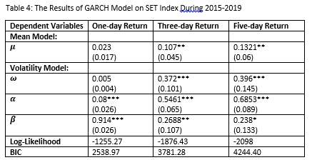
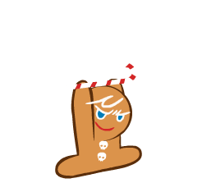
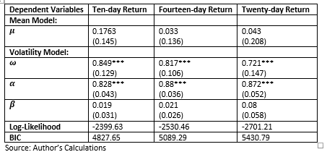

Results from SET Index

Slide 15

Results from SET Index

Slide 16
Possible Complications?
Moving from SET Index to individual stocks is not easy.
What stocks should we include in the analysis?
How do we display the results?
Is it feasible to run on all stocks? By hand?

Slide 17

Data Preparation (GOALS)
Individual GARCH:
$r_{t,n}^{i}=μ_{n}^{i}+ε_{t,n}^{i}$
${σ^{i}}_{t,n}^{2}=ω_{n}^{i}+α_{n}^{i}{ε^{i}}_{t−1,n}^{2}+β_{n}^{i}{σ^{i}}_{t−1,n}^{2}$
Individual GJR-GARCH:
$r_{t,n}^{i}=μ_{n}^{i}+ε_{t,n}^{i}$
${σ^{i}}_{t,n}^{2}=ω_{n}^{i}+α_{n}^{i}{ε^{i}}_{t−1,n}^{2}+γ_{n}^{i}{ε^{i}}_{t−1,n}^{2}I_{[ε_{t−1,n}^{i}<0]}+β_{n}^{i}{σ^{i}}_{t−1,n}^{2}$

Slide 18
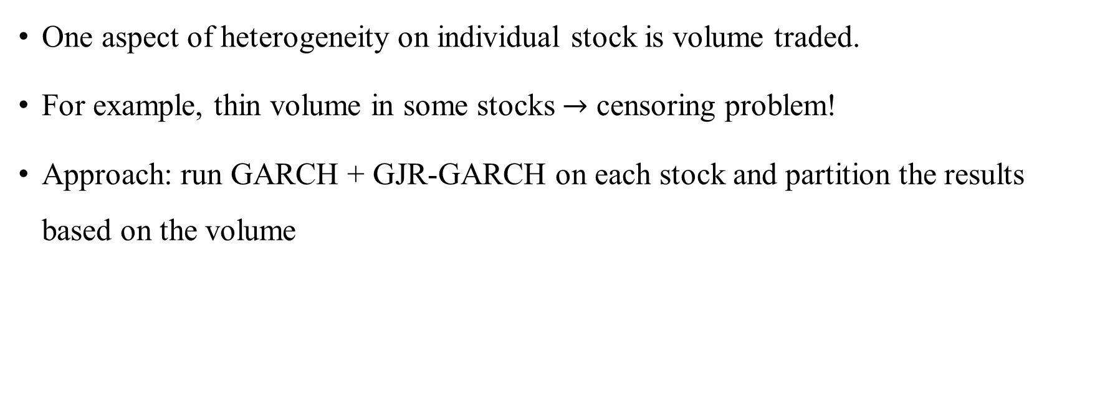
Aggregating the Result
One aspect of heterogeneity on individual stock is volume traded.
For example, thin volume in some stocks $→$ censoring problem!
Approach: run GARCH + GJR-GARCH on each stock and partition the results based on the volume
Inspiration: Brooks, R. D., Faff, R. W., & Fry, T. R. (2001). GARCH Modeling of Individual Stock Data: The Impact of Censoring, Firm Size and Trading Volume. Journal of International Financial Markets, Institutions and Money, 11(2), 215-222.

Slide 19
SWITCH TO THE NOTEBOOK

Slide 20


Results Discussion (Bird-eye view)
Abstract
Introduction
Conclusion
Inspiration: https://www.youtube.com/watch?v=x8B_BQ2cxIc&ab_channel=MoleManiac

Slide 21
Results - Abstract
The study has found that the volatility behavior (in SET index) is different across investment periods.
ARCH effects are statistically significant for most individual stocks.
The volatility behavior is similar across stocks with traded volume, and the behavior is different across investment periods, similar to the results in SET index.

Slide 22
Results – Intro
By running these two models on SET index, the study found different volatility behavior across investment periods.
For short investment periods (1-day, 3-day), the coefficients on lagged variance, past shocks and asymmetry are statistically significant.
For longer periods (5-day, 10-day, 14-day, 20-day), only the coefficient on past shocks is statistically significant.

Slide 23
Results - Intro
By comparing the magnitude of coefficients, volatility behavior is different across investment periods.
For short investment periods (1-day, 3-day), the coefficient on past shock is smaller, and the coefficient on lagged variance is larger than the coefficients found in longer periods (5-day, 10-day, 14-day, 20-day).
The differences in volatility behavior from shorter period to longer period are similar to what the study has found in SET index.
Furthermore, the result is similar across stocks with different traded volume.

Slide 24
Results – Conclusion
(SET IDX) The implication is that traders need to take their investment periods into account when analyzing volatility as volatility behavior is different along different investment periods.
(SET IDX) For policymakers, in order to forecast market volatility, lagged volatility is a good guess in a very short trading period, but the effect of past shocks dominates in a longer period.
(Individual) The implication is that in order to forecast volatility in individual stocks, traders and policymakers can employ these volatility models, and expect that the behaviors would be different across trading horizons, in a way that is similar to the behavior found in SET index.

Slide 25
Any questions?

